Slide 1
Knowledge-based agents
Chapter 7

Slide 2
Outline
Knowledge-based agents
Wumpus world
Logic in general—models and entailment
Propositional (Boolean) logic
Equivalence, validity, satisfiability
Inference rules and theorem proving
forward chaining
backward chaining
resolution

Slide 3
Knowledge-based agents
Inference engine
domain−independent algorithms
Knowledge base
domain−specific representation (conceptual knowledge) and problem-specific representation (factual knowledge)
Knowledge-based approach to problem solving assumes that the agent architecture includes two separate layers
Knowledge base (KB) = set of sentences, written in a formal representation language
Inference engine (IE) = set of inference rules and inference algorithm (entailment) for applying them to KB, written in a formal meta-language
Declarative approach to use an agent within intelligent systems relies on two communication operations:
Tell it what it needs to know – it goes to the KB
Ask itself what to do—answers should follow from the KB
Agents behavior can be traced on two separate levels
At the knowledge level - what is there and how to do in a formal language, regardless of how it has been implemented
Or at the implementation level - data structures in KB and algorithms that manipulate them

Slide 4
A simple knowledge-based agent
function KB-Agent( percept) returns an action
static: KB, a knowledge base, contains facts and
t, a counter, initially 0, indicating step
Tell(KB, Make-Percept-Sentence( percept, t))
action ← Ask(KB, Make-Action-Query(t))
Tell(KB, Make-Action-Sentence(action, t))
t ← t + 1
return action
The agent must be able to:
Represent in its KB percepts, states, actions, etc. (Knowledge Representation)
Incorporate in its KB new percepts (Knowledge Acquisition)
Update internal representations of the world in the KB (Knowledge Update)
Infer hidden properties of the world (Knowledge Inference)
Infer appropriate actions (Action Planning)
Update external world (Action Execution)
In order to be rational it must follow certain logic
Formal Logic
Graph Theory
Abstract Algebra, etc.

Slide 5
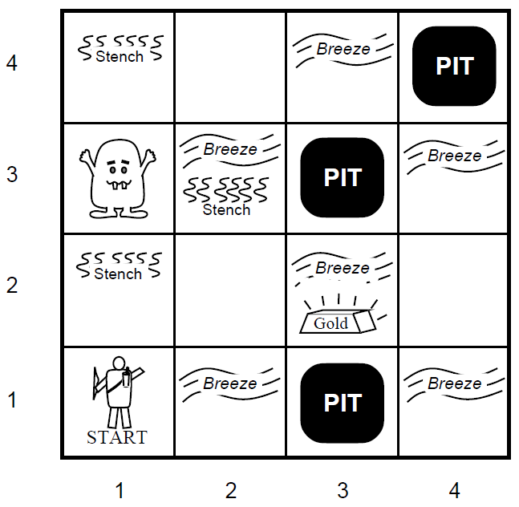
Wumpus World PEAS description
The Wumpus world is a simple world example to illustrate the worth of a knowledge-based agent and its knowledge representation. It is a cave with 4/4 rooms containing pits which are connected with passageways. The goal of the agent is to find the gold and take it while keeping away from the pits and possibly shooting the Wumpus if meeting it. The perception of the agent hints for the Wumpus by its stench and for neighbour pits by the breeze. It was inspired by a video game Hunt the Wumpus by Gregory Yob in 1973.
Performance measure
gold +1000, death -1000 – game ends
-1 per step back, -10 for using arrow
Environment
Squares adjacent to wumpus have Stench
Squares adjacent to pit are Breezy
Glitter iff gold is in the same square
Shooting kills wumpus if you are facing it using an arrow
Grabbing picks up gold if in same square
Releasing drops the gold in same square
Actuators: Left turn, Right turn, Forward, Back, Grab, Release, Shoot, Fall in, Climb out
Sensors: Breeze, Glitter, Stench, Bump, Scream

Slide 6
Wumpus world characterization
Observable??

Slide 7
Wumpus world characterization
Observable?? No—only local perception
Deterministic??

Slide 8
Wumpus world characterization
Observable?? No—only local perception
Deterministic?? Yes—outcomes exactly specified Episodic??

Slide 9
Wumpus world characterization
Observable?? No—only local perception
Deterministic?? Yes—outcomes exactly specified Episodic?? No—sequence of actions until end Static??

Slide 10
Wumpus world characterization
Observable?? No—only local perception
Deterministic?? Yes—outcomes exactly specified Episodic?? No—sequence of actions until end Static?? Yes—Wumpus and Pits do not move Discrete??

Slide 11
Wumpus world characterization
Observable?? No—only local perception
Deterministic?? Yes—outcomes exactly specified Episodic?? No—sequence of actions until end Static?? Yes—Wumpus and Pits do not move Discrete?? Yes
Single-agent??

Slide 12
Wumpus world characterization
Observable?? No—only local perception
Deterministic?? Yes—outcomes exactly specified Episodic?? No—sequence of actions until end Static?? Yes—Wumpus and Pits do not move Discrete?? Yes
Single-agent?? Yes—Wumpus is essentially a natural feature

Slide 13
Exploring a wumpus world
OK
OK X | OK

Slide 14
Exploring a wumpus world
S
OK
X
OK
OK
X

Slide 15
Exploring a wumpus world
W?
S
OK
W?
X
OK
OK
X

Slide 16
Exploring a wumpus world
W?
W
S
OK
W?
W
X
OK
B
OK
X
X

Slide 17
Exploring a wumpus world
W?
W
S
OK
W OK
X
OK
X
B
OK
X
P?

Slide 18
Exploring a wumpus world
W?
W
S
OK
W? OK
X
X
OK
X
B
OK
X
P

Slide 19
Exploring a wumpus world
W?
OK
W
S
OK
W? OK
OK
X
X
OK
X
B
OK
X
P

Slide 20
Exploring a wumpus world
W?
OK
W
S
OK
W? BGS OK OK
X
X
X
OK
X
B
OK
X
P

Slide 21
Tight spots
P?
Breeze in (1,2) and (2,1)
⇒ no safe actions forward
Assuming pits uniformly distributed,
(2,2) has pit vs. w / prob 0.86, vs. 0.31
B OK
P?
P?
X
OK B OK
P?
X
X
Smell in (1,1)
⇒ cannot move
Can use a strategy of coercion:
wumpus wasn’t there ⇒ safe
S
X
wumpus was there ⇒ dead ⇒ not safe
⇒ so shoot straight ahead
Chapter 7
21

Slide 22
Logic in general
Logics are formal languages for representing information such that conclusions can be drawn
Syntax defines the sentences in the language
Semantics define the “meaning” of sentences;
i.e., defines the truthfulness of a sentence in a world
Example: the language of arithmetic
x + 2 ≥ y is a sentence;
x2 + y > is not a sentence
x + 2 ≥ y is true iff the number x + 2 is no less than the number y
x + 2 ≥ y is true in a world where x = 7, y = 1 and false where x = 0, y = 6

Slide 23
Entailment
Entailment means that one thing follows logically from another with respect to its truthfulness:
KB |= α
Knowledge base KB entails sentence α if and only ifα is true in all worlds where KB is true
Example: the KB containing “the Giants won” and “the Reds won” entails “Either the Giants won or the Reds won”
Example: x + y = 4 entails 4 = x + y
Entailment is a relationship between sentences (i.e., syntax) that is based on semantics
Note: brains process both syntax and semantics (of some sort)

Slide 24
Models
Logicians typically think in terms of models, which are formally structured worlds with respect to which truth can be evaluated
We say m is a model of a sentence α if α is true in m
M (α) is the set of all models of α
Then KB |= α if and only if M (KB) ⊆ M (α)
Example: KB = Giants won and Reds won
α = Giants won
x
x x
x
M(α)
x
x
_{x} x
x
x_{x}
x
x
x
x x
x
x
x _{x}
x
x
x
x
x
x
x x
x
xx
_{x} x xx x
x x
x
x
M(KB)
x
x
x
x
x
x
x

Slide 25
Entailment in the wumpus world
Situation after detecting nothing in [1,1], moving right, breeze in [2,1]
? ?
B
?
Consider possible models for
the world assuming only pits
3 Boolean choices ⇒ 8 possible models
X
X

Slide 26










Wumpus models
2
2
1
Breeze
1
Breeze
1
2
3
1
2
3
2
2
2
Breeze
1
Breeze
Breeze
1
1
2
3
1
1
2
3
1 2
3
2
2
1
Breeze
1
Breeze
2
1
2
3
1
2
3
Breeze
1
1
2
3

Slide 27












Wumpus models
2
PIT
2
1
Breeze
PIT
1
Breeze
KB
1
2
3
1
2
3
PIT
2
PIT
2
2
PIT
1
Breeze
1
Breeze
1
Breeze
1
2
3
1
2
3
1 2
3
PIT
2
PIT
PIT
2
1
Breeze
PIT
PIT
PIT
1
Breeze
2
1
2
3
1
2
3
Breeze
PIT
1
1
2
3
KB = wumpus-world rules + observations

Slide 28

Wumpus models
2
PIT
2
1
Breeze
PIT
1
Breeze
KB
1
2
3
1
2
3
1
PIT
2
PIT
2
2
PIT
1
Breeze
1
Breeze
1
Breeze
1
2
3
1
2
3
1 2
3
PIT
2
PIT
PIT
2
1
Breeze
PIT
PIT
PIT
1
Breeze
2
1
2
3
1
2
3
Breeze
PIT
1
1
2
3
KB = wumpus-world rules + observations
α₁ = “[1,2] is safe”, KB |= α₁, proved by model checking

Slide 29
Wumpus models
2
PIT
2
1
Breeze
PIT
1
Breeze
KB
1
2
3
1
2
3
PIT
2
PIT
2
2
PIT
1
Breeze
1
Breeze
1
Breeze
1
2
3
1
2
3
1 2
3
PIT
2
PIT
PIT
2
1
Breeze
PIT
PIT
PIT
1
Breeze
2
1
2
3
1
2
3
Breeze
PIT
1
1
2
3
KB = wumpus-world rules + observations

Slide 30
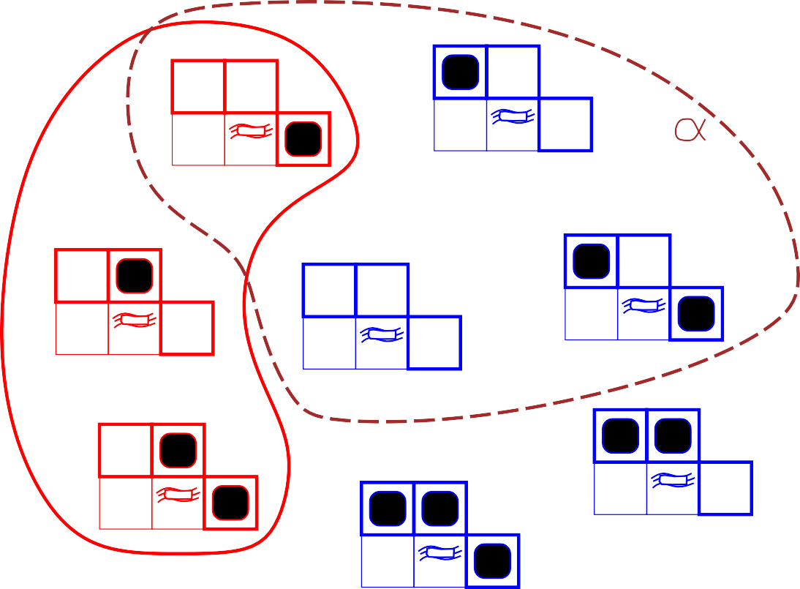
Wumpus models
2
2
PIT
1
Breeze
PIT
1
Breeze
2
KB
1
2
3
1
2
3
2
PIT
2
PIT
2
1
Breeze
PIT
1
Breeze
1
Breeze
1
2
3
1
2
3
1
2
3
2
PIT
2
PIT
PIT
1
Breeze
PIT
1
Breeze
2 PIT
PIT
1
2
3
1
2
3
1
Breeze
PIT
1
2
3
KB = wumpus-world rules + observations
α₂ = “[2,2] is safe”, KB |= α₂

Slide 31
Inference
KB ⊢_{i} α = sentence α can be derived from KB by procedure i
Consequences of KB are a haystack; α is a needle.
Entailment = needle in haystack; inference = finding it
Soundness: i is sound if
whenever KB⊢_{i} α, it is also true that KB ⊨ α
Completeness: i is complete if
whenever KB ⊨ α, it is also true that KB ⊢_{i} α
That is, the procedure will answer any question whose answer follows from what is known by the KB.

Slide 32
Propositional logic: Syntax
Propositional logic is the simplest logic—illustrates basic ideas
The proposition symbols P₁, P₂ etc are sentences
If S is a sentence, ¬S is a sentence (negation)
If S₁ and S₂ are sentences, S₁ ∧ S₂ is a sentence (conjunction)
If S₁ and S₂ are sentences, S₁ ∨ S₂ is a sentence (disjunction)
If S₁ and S₂ are sentences, S₁ ⇒ S₂ is a sentence (material implication)
If S₁ and S₂ are sentences, S₁ ⇔ S₂ is a sentence (material equivalence)

Slide 33
Propositional logic: Semantics
Each model specifies true/false for each proposition symbol
E.g.
P1,2 P2,2 P3,1
true true false
(With these symbols, 8 possible models, can be enumerated automatically.)
Rules for evaluating truth with respect to a model m:
¬S
is true iff is true iff is true iff is true iff is false iff is true iff
S is false
S₁ is true and
S₁ is true or
S₁ is false or
S₁ is true and
S₁ ⇒ S₂ is true and S₂
S₁ ∧ S₂
S₂ is true
S₂ is true
S₂ is true
S₂ is false
⇒ S₁ is true
S₁ ∨ S₂
S₁ ⇒ S₂
i.e.,
S₁ ⇔ S₂
Simple recursive process evaluates an arbitrary sentence
Example: ¬P_{1,2} ∧ (P_{2,2} ∨ P_{3,1}) = true ∧ (false ∨ true) = true ∧ true = true

Slide 34
Truth tables for connectives
P | Q | ¬P | P ∧ Q | P ∨ Q | P ⇒Q | P ⇔Q
false | false | true | false | false | true | true
false | true | true | false | true | true | false
true | false | false | false | true | false | false
true | true | false | true | true | true | true

Slide 35
Wumpus world description
Example: Let P_{i,j} be true if there is a pit in [i, j] and let B_{i,j} be true if there is a breeze in [i, j]. Then the following sentences are true in the Wumpus world
¬P1,1
“No pit in [1,1]”
¬B1,1
“No breeze in [1,1]”
B2,1
“Breeze in [2,1]”

Slide 36
Wumpus world sentences
Let P_{i,j} be true if there is a pit in [i, j].
Let B_{i,j} be true if there is a breeze in [i, j].
¬P1,1
¬B1,1
B2,1
“Pits cause breezes in adjacent squares”
B1,1 B2,1
⇔
⇔
(P1,2 ∨ P2,1)
(P1,1 ∨ P2,2 ∨ P3,1)
“A square is breezy if and only if there is an adjacent pit”

Slide 37
Truth tables for inference
B1,1 | B2,1 | P1,1 | P1,2 | P2,1 | P2,2 | P3,1 | R₁ | R₂ | R₃ | R₄ | R₅ | KB
false false . false | false false . true | false false . false | false false . false | false false . false | false false . false | false true . false | true true . true | true true . true | true false . false | true true . true | false false . true | false false . false
false false false | true true true | false false false | false false false | false false false | false true true | true false true | true true true | true true true | true true true | true true true | true true true | true true true
false . true | true . true | false . true | false . true | true . true | false . true | false . true | true . false | false . true | false . true | true . false | true . true | false . false
Enumerate rows (different assignments to symbols), if KB is true in row, check that α is too

Slide 38
Inference by enumeration
Depth-first enumeration of all models is sound and complete
function TT-Entails?(KB, α) returns true or false
inputs: KB, the knowledge base, a sentence in propositional logic
α, the query, a sentence in propositional logic
symbols ← a list of the proposition symbols in KB and α
return TT-Check-All(KB, α, symbols, [ ])
function TT-Check-All(KB, α, symbols, model) returns true or false
if Empty?(symbols) then
if PL-True?(KB, model) then return PL-True?(α, model)
else return true
else do
P ← First(symbols); rest ← Rest(symbols)
return TT-Check-All(KB, α, rest, Extend(P , true, model )) and
TT-Check-All(KB, α, rest, Extend(P , false, model ))
O(2^{n}) for n symbols; problem is co-NP-complete

Slide 39
Logical equivalence
Two sentences are logically equivalent iff true in same models:
α ≡ β if and only if α |= β and β |= α
(α ∧ β) ≡ (β ∧ α) commutativity of ∧
(α ∨ β) ≡ (β ∨ α) commutativity of ∨ ((α ∧ β) ∧ γ) ≡ (α ∧ (β ∧ γ)) associativity of ∧ ((α ∨ β) ∨ γ) ≡ (α ∨ (β ∨ γ)) associativity of ∨
¬(¬α) ≡ α double-negation elimination
(α ⇒ β) ≡ (¬β ⇒ ¬α) contraposition
(α ⇒ β) ≡ (¬α ∨ β) implication elimination
(α ⇔ β) ≡ ((α ⇒ β) ∧ (β ⇒ α)) biconditional elimination
¬(α ∧ β) ≡ (¬α ∨ ¬β) De Morgan
¬(α ∨ β) ≡ (¬α ∧ ¬β) De Morgan
(α ∧ (β ∨ γ)) ≡ ((α ∧ β) ∨ (α ∧ γ)) distributivity of ∧ over ∨
(α ∨ (β ∧ γ)) ≡ ((α ∨ β) ∧ (α ∨ γ)) distributivity of ∨ over ∧

Slide 40
Validity and satisfiability
A sentence is valid if it is true in all models,
e.g., True, A ∨ ¬A, A ⇒ A, (A ∧ (A ⇒ B)) ⇒ B
Validity is connected to inference via the Deduction Theorem:
KB ⊨α if and only if (KB ⇒ α) is valid
A sentence is satisfiable if it is true in some model e.g., A ∨ B, C
A sentence is unsatisfiable if it is true in no models e.g., A ∧ ¬A
Satisfiability is connected to inference via the following:
KB ⊨α if and only if (KB ∧ ¬α) is unsatisfiable
i.e., prove α by reductio ad absurdum

Slide 41
Proof methods
Proof methods divide into (roughly) two kinds:
Application of inference rules
Legitimate (sound) generation of new sentences from old
Proof = a sequence of inference rule applications
Can use inference rules as operators in a standard search alg.
Typically require translation of sentences into a normal form
Model checking
truth table enumeration (always exponential in n)
improved backtracking, e.g., Davis–Putnam–Logemann–Loveland heuristic search in model space (sound but incomplete)
e.g., min-conflicts-like hill-climbing algorithms

Slide 42
Forward and backward chaining
Horn Form (restricted)
KB = conjunction of Horn clauses
Horn clause =
proposition symbol; or
(conjunction of symbols) ⇒ symbol E.g., C ∧ (B ⇒ A) ∧ (C ∧ D ⇒ B)
Modus Ponens (for Horn Form): complete for Horn KBs
α₁, . . . , α_{n}, α₁ ∧ · · · ∧ α_{n} ⇒ β β
Can be used with forward chaining or backward chaining. These algorithms are very natural and run in linear time

Slide 43
Forward chaining
Idea: fire any rule whose premises are satisfied in the KB, add its conclusion to the KB, until query is found
Q
P ⇒ Q
L ∧ M ⇒ P B ∧ L ⇒ M A ∧ P ⇒ L
P
M
A ∧ B ⇒ L
A B
L
A
B

Slide 44
Forward chaining algorithm
function PL-FC-Entails?(KB, q) returns true or false
inputs: KB, the knowledge base, a set of propositional Horn clauses
q, the query, a proposition symbol
local variables: count, a table, indexed by clause, initially the number of premises inferred, a table, indexed by symbol, each entry initially false agenda, a list of symbols, initially the symbols known in KB
while agenda is not empty do p ← Pop(agenda) unless inferred[p] do
inferred[p] ← true
for each Horn clause c in whose premise p appears do
decrement count[c]
if count[c] = 0 then do
if Head[c] = q then return true
Push(Head[c], agenda)
return false

Slide 45
Forward chaining example
Q
1
P
2
M
2
L
2
2
A
B

Slide 46
Forward chaining example
Q
1
P
2
M
2
L
1
1
A
B

Slide 47
Forward chaining example
Q
1
P
2
M
1
L
1
0
A
B

Slide 48
Forward chaining example
Q
1
P
1
M
0
L
1
0
A
B

Slide 49
Forward chaining example
Q
1
P
0
M
0
L
1
0
A
B

Slide 50
Forward chaining example
Q
0
P
0
M
0
L
0
0
A
B

Slide 51
Forward chaining example
Q
0
P
0
M
0
L
0
0
A
B

Slide 52
Forward chaining example
Q
0
P
0
M
0
L
0
0
A
B

Slide 53
Proof of completeness
FC derives every atomic sentence that is entailed by KB
FC reaches a fixed point where no new atomic sentences are derived
Consider the final state as a model m, assigning true/false to symbols
Every clause in the original KB is true in m
Proof: Suppose a clause a₁ ∧ . . . ∧ a_{k} ⇒ b is false in m Then a₁ ∧ . . . ∧ a_{k} is true in m and b is false in m Therefore the algorithm has not reached a fixed point!
Hence m is a model of KB
If KB ⊨q, q is true in every model of KB, including m
General idea: construct any model of KB by sound inference, check α

Slide 54
Backward chaining
Idea: work backwards from the query q: to prove q by BC,
check if q is known already, or
prove by BC all premises of some rule concluding q
Avoid loops: check if new subgoal is already on the goal stack
Avoid repeated work: check if new subgoal
has already been proved true, or
has already failed

Slide 55
Backward chaining example
Q
P
M
L
A
B

Slide 56
Backward chaining example
Q
P
M
L
A
B

Slide 57
Backward chaining example
Q
P
M
L
A
B

Slide 58
Backward chaining example
Q
P
M
L
A
B

Slide 59
Backward chaining example
Q
P
M
L
A
B

Slide 60
Backward chaining example
Q
P
M
L
A
B

Slide 61
Backward chaining example
Q
P
M
L
A
B

Slide 62
Backward chaining example
Q
P
M
L
A
B

Slide 63
Backward chaining example
Q
P
M
L
A
B

Slide 64
Backward chaining example
Q
P
M
L
A
B

Slide 65
Backward chaining example
Q
P
M
L
A
B

Slide 66
Forward vs. backward chaining
FC is data-driven, cf. automatic, unconscious processing, e.g., object recognition, routine decisions
May do lots of work that is irrelevant to the goal
BC is goal-driven, appropriate for problem-solving,
e.g., Where are my keys? How do I get into a PhD program?
Complexity of BC can be much less than linear in size of KB

Slide 67
Resolution
Conjunctive Normal Form (CNF—universal)
conjunction of disjunctions of literals
..
cla uses
E.g., (A ∨ ¬B) ∧ (B ∨ ¬C ∨ ¬D)
Resolution inference rule (for CNF): complete for propositional logic
/J₁ ∨ · · · ∨ /J_{k}, m₁ ∨ · · · ∨ m_{n}
/J₁ ∨ · · · ∨ /J_{i−1} ∨ /J_{i+1} ∨ · · · ∨ /J_{k} ∨ m₁ ∨ · · · ∨ m_{j−1} ∨ m_{j+1} ∨ · · · ∨ m_{n}
where /J_{i} and m_{j} are complementary literals. E.g.,
P1,3 ∨ P2,2, ¬P2,2
P
P?
P1,3
B OK
A
P? OK
A
Resolution is sound and complete for propositional logic
OK S
A
OK
A
W

Slide 68
Conversion to CNF
B1,1 ⇔ (P1,2 ∨ P2,1)
1. Eliminate ⇔, replacing α ⇔ β with (α ⇒ β) ∧ (β ⇒ α).
(B1,1
⇒ (P_{1,2} ∨ P_{2,1})) ∧ ((P_{1,2} ∨ P_{2,1}) ⇒ B_{1,1})
Eliminate ⇒, replacing α ⇒ β with ¬α ∨ β.
(¬B_{1,1} ∨ P_{1,2} ∨ P_{2,1}) ∧ (¬(P_{1,2} ∨ P_{2,1}) ∨ B_{1,1})
Move ¬ inwards using de Morgan’s rules and double-negation:
(¬B_{1,1} ∨ P_{1,2} ∨ P_{2,1}) ∧ ((¬P_{1,2} ∧ ¬P_{2,1}) ∨ B_{1,1})
Apply distributivity law (∨ over ∧) and flatten:
(¬B_{1,1} ∨ P_{1,2} ∨ P_{2,1}) ∧ (¬P_{1,2} ∨ B_{1,1}) ∧ (¬P_{2,1} ∨ B_{1,1})

Slide 69
Resolution algorithm
Proof by contradiction, i.e., show KB ∧ ¬α unsatisfiable
function PL-Resolution(KB, α) returns true or false
inputs: KB, the knowledge base, a sentence in propositional logic
α, the query, a sentence in propositional logic
clauses ← the set of clauses in the CNF representation of KB ∧ ¬α
new ← { }
loop do
for each C_{i}, C_{j} in clauses do
resolvents ← PL-Resolve(C_{i}, C_{j} )
if resolvents contains the empty clause
then return true new ← new ∪ resolvents
if new ⊆ clauses then return false clauses ← clauses ∪ new

Slide 70
Resolution example
KB = (B_{1,1} ⇔ (P_{1,2} ∨ P_{2,1})) ∧ ¬B_{1,1} α = ¬P_{1,2}
P2,1 B1,1
B1,1 P1,2 P2,1
P1,2
B1,1
B1,1
P1,2
B1,1
P1,2
B1,1
P1,2
P2,1
P1,2
B1,1
P2,1
B1,1 _{P1,2}
P2,1
P2,1
P2,1
P1,2

Slide 71
Summary
Logical agents apply inference to a knowledge base to derive new information and make decisions
Basic concepts of logic:
syntax: formal structure of sentences
semantics: truth of sentences wrt models
entailment: necessary truth of one sentence given another
inference: deriving sentences from other sentences
soundess: derivations produce only entailed sentences
completeness: derivations can produce all entailed sentences
Wumpus world requires the ability to represent partial and negated informa- tion, reason by cases, etc.
Forward, backward chaining are linear-time, complete for Horn clauses Resolution is complete for propositional logic
Propositional logic lacks expressive power

